Slide 1
ACCIDENT SEVERITY AND ANALYSIS REPORT
BY JATIN YOGESH TERDE
SPECIAL CREDITS: Tejali Gangane

Slide 2
INDEX
1. INTRODUCTION
2. PROBLEM STATEMENT
3. ABOUT DATA
4. METHODOLOGY
5. ACCIDENT TYPES & LOCATIONS
6. ASUMING REASONS
6. CONCLUSION

Slide 3
INTRODUCTION
Accidents are an usual issue. Accidents occur due to many issues and cause small or huge amount of loss to property and person.
How do accidents occur or what can be the possible reasons for an accident to occur and many other issues like severity of the accident have been explained in the project before. Adding to the data here explaining the data visuals and reasons behind the accidents.
The report is solemnly focused on giving idea about reasons behind accident and precautions over it.

Slide 4
Problem statement
Identify the factors responsible to understand how severe the accident actually is. Depicting various aspects behind an accident from the given data and analyzing the same.

Slide 5
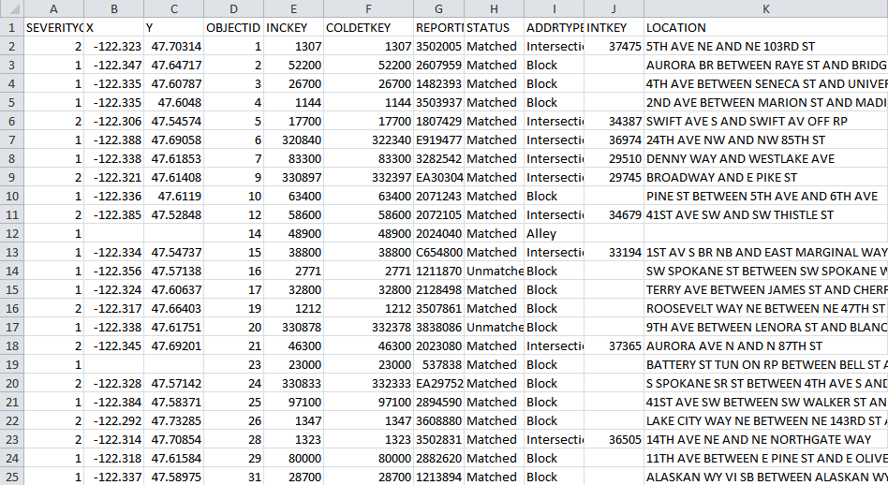
About data
The data set which will be used is the Data-Collisions provided through the Applied Data Science Capstone by Coursera. The data consists of the information about the accidents. The data has 194,673 rows and 38 columns. The columns are referred as the features of the dataset.

Slide 6
METHODOLOGY
INTERPRETITION
THE REPORT IS CONCENERED TO ADD UP MORE CLARITY TO THE “ACCIDENT SEVERITY CODE PREDICTION” AND DEPECT THE DATA IN MORE VISUAL MANNER.
THE CONCEPT IS TO MAP THE DATA AND UNDERSTAND THE REASON BEHIND THE ACCIDENTS. LATER PRESENTING THE MEASURES AND SEVERITY PREDICTIONS.
USE OF TABLEAU PUBLIC
THE DATA WAS ANALYZED AND VISUALIZED IN THE TABLEAU IDE .VISUALS ARE DATA FOCUSED AND THE TRY WAS TO EXPLAIN THE ACCIDENT SCENARIOS IN PROPER PICTORICAL MANNER.

Slide 7
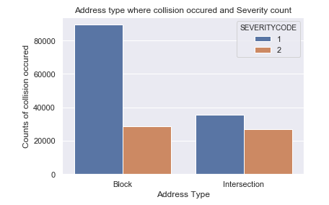
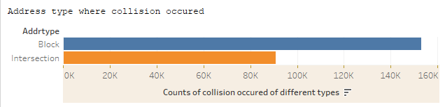
1. ADDRESS AND SEVERITY OF ACCIDENT
ACCIDENT TYPES & LOCATIONS
According to the data, it seems to be clear that more accidents occur at the block rather than the intersection
But, the reasons remain unknown and hence nothing can be stated.

Slide 8
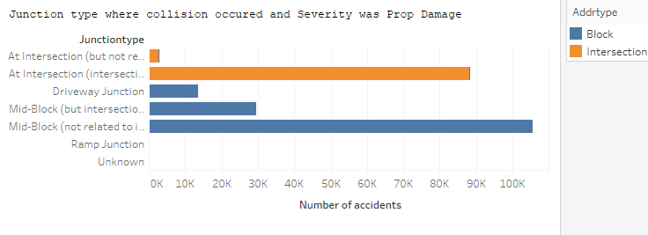
2. place of occurrence with accident numbers
Getting in detail about the actual occurrence we also need to know severity of accident , type of accident and actual location .

Slide 9
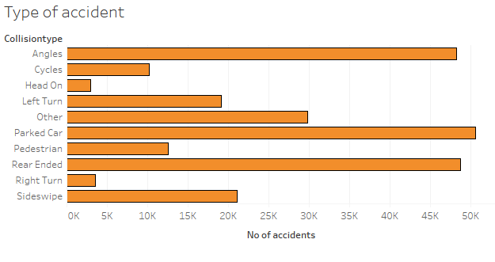
3. The accident types
Accidents occurred in vivid manners.. A more clear and differentiae view about the type of accident with its place is shown in the next slide.

Slide 10
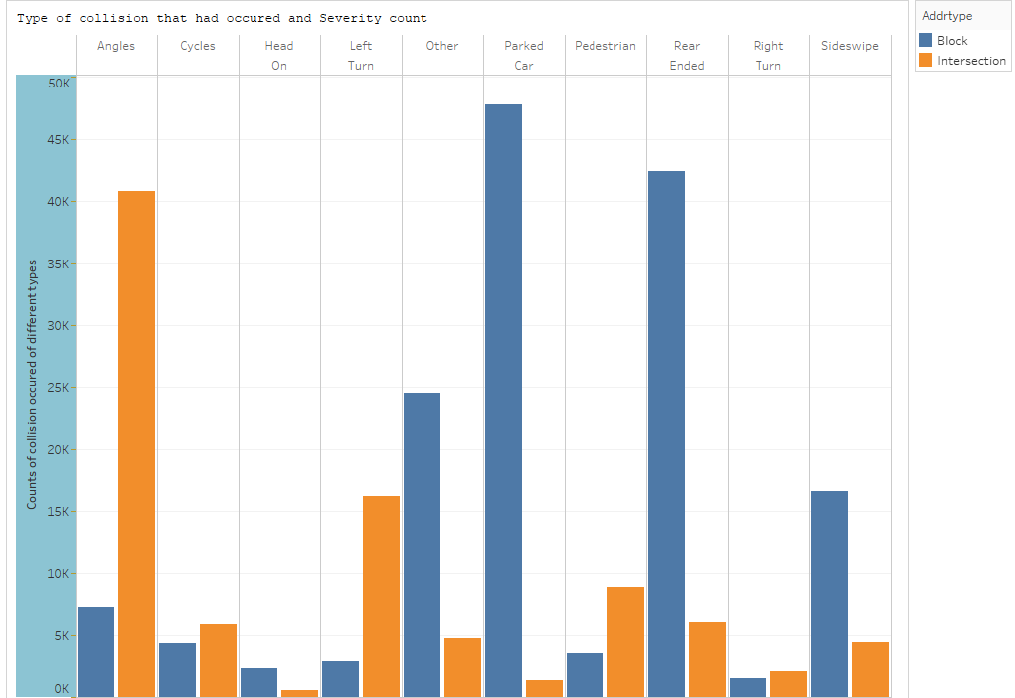
The type of collision with the address

Slide 11
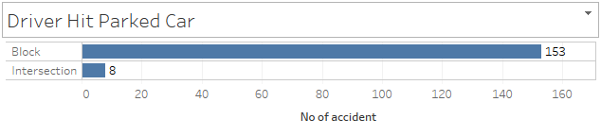
1. hitting a parked car
ASUMING REASONS
New learning drivers usually hit a parked car . It is because they usually loose their control and get bumped into parked cars in panic

Slide 12
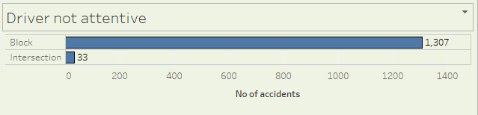
2. Non attentive driver
Being Non attentive while driving has caused considerable amount of accidents. Such accidents are observed more in the block than at intersection.

Slide 13
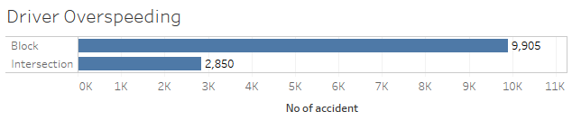
3. over speeding
Over Speeding has been the main reason of accident. The driver over speeds and gets himself in situations of occurrence of accidents . The amount of accidents due to Over Speeding in the block as well as Intersection cannot be neglected.

Slide 14
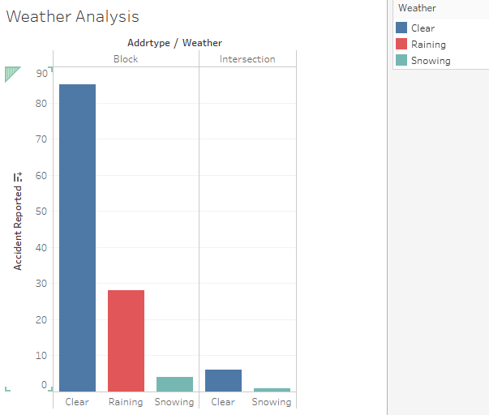
4. Considering weather
According to the data there seems to be no special effect of weather changes in the amount of accident occurrence.

Slide 15
conclusion
Data isn’t enough to commit to severity of accidents and calculating risks . But, certain measures are certainly essential.
Drivers must avoid over speeding and must drive with complete attention on road no matter whether he is driving in the block or at intersection.
Vehicles parked improperly in the block zone might cause increase in accident rate in the block.
Weather isn’t usually responsible for accident.
More data is required for accurate classification . If more data were to be present better results and conclusions can be gained.

